Slide 1
Magical Weapon Warfare(Placeholder name)
Godot RPG that combines elements of other RPG sub-genres together

Slide 2

How it will work
I plan on combining three sub-geners together to make one hybrid game.
Two combat phases
Phase one is More tactical(explained later)
Phase two is more combat focused(explained later)

Slide 3
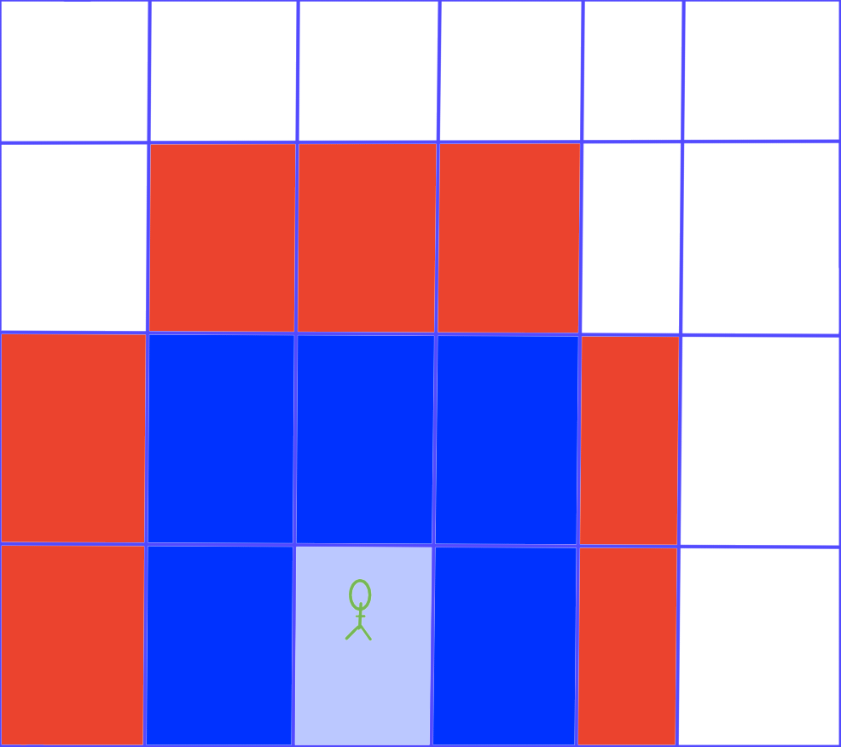
Genre 1 : Tactical Role playing Game(TRPG)
Used in phase one and effects phase two.
Examples of this include Fire emblem and advanced wars .
The main focal point is planning attacks and tile-map based combat.
Where the combat outcome isn’t controlled by the player .
Blue is moving range.
Red is where you can attack.

Slide 4
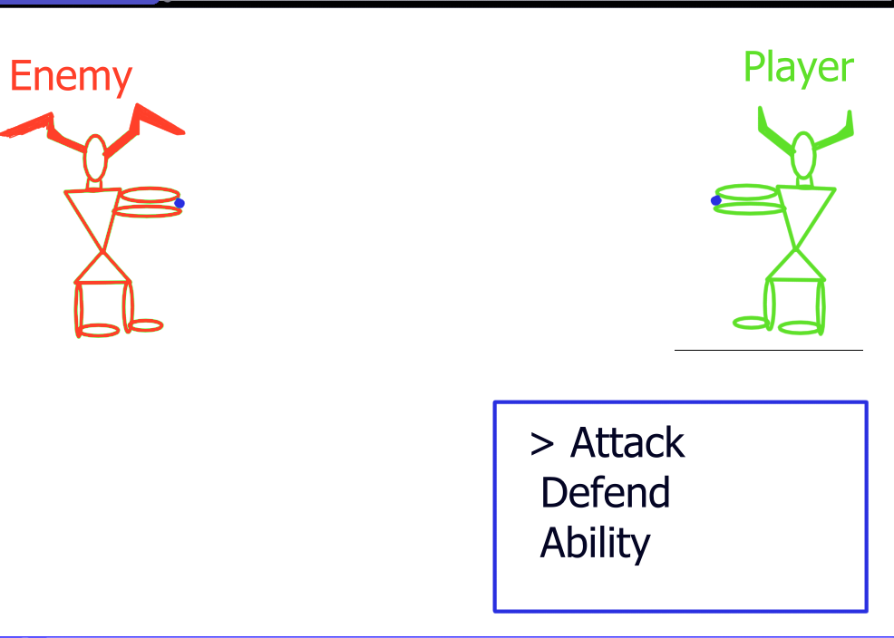
Genre 2: Turn based
Examples Final fantasy , Persona
Turn based with what I am referring to is when you can select an action and then it executes your action.

Slide 5
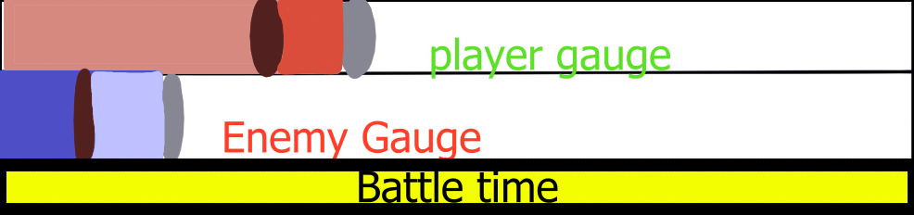
Genre 3: Strategy/ATP (from Final fantasy 7)
This is a hybrid one, so by strategy I mean where you can’t just attack to win over and over again.
By atp I mean where your actions have a Cost associated to them and that determines when you can make another attack.
The player and enemy both have an attack and recvory to attack. With an overall time that ends the battle when it hits 0.

Slide 6
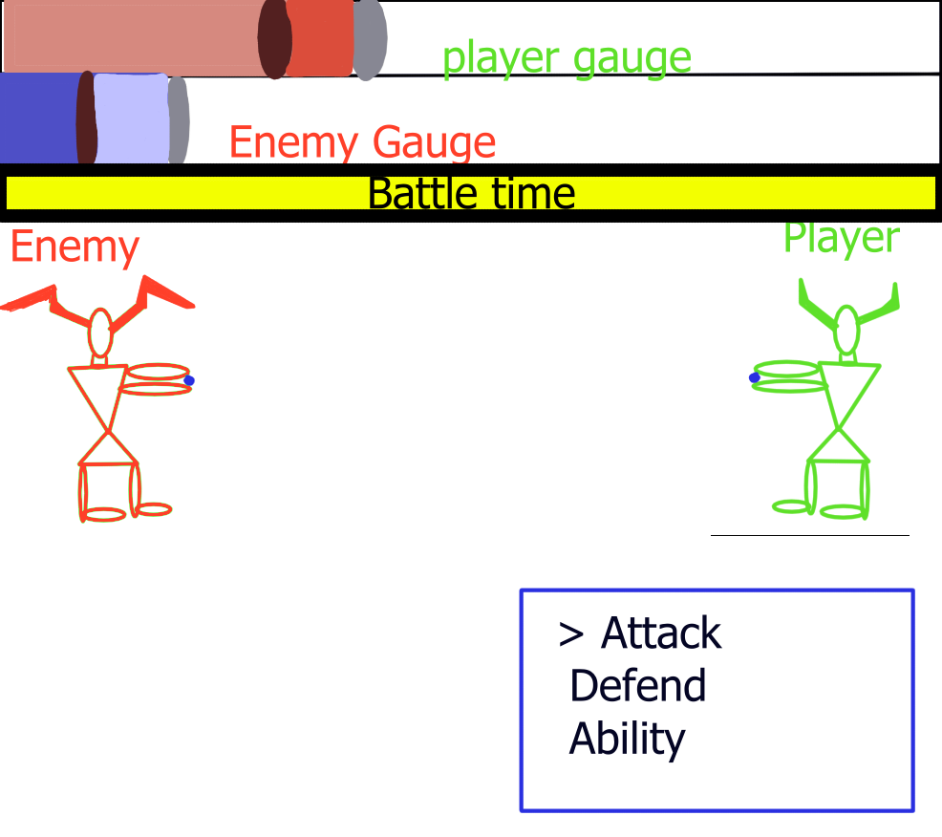
In summary
It starts with the Tactic and tile based movement when you attack
It then goes into turn based in turned based it has an bar that determines recovery and attack and battle time after this it heads back to tactic mode.
Tactic mode influences battle time.

